Slide 1

Walmart analysis report

Slide 2
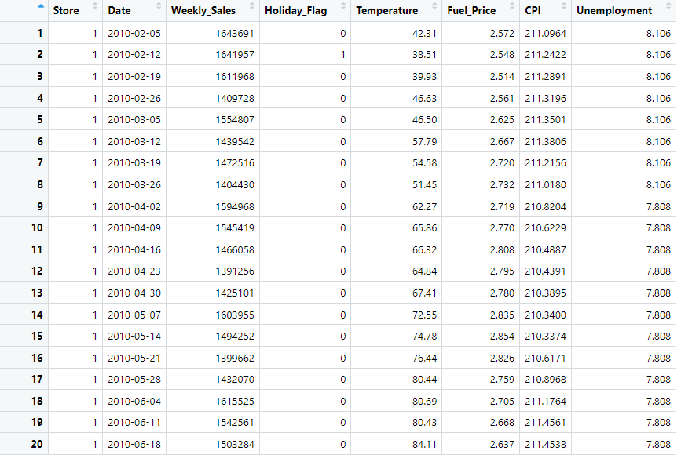
Information
Sample data after converting Date column into a date data type
Walmart data on:
Store Number
Date of the week
Weekly Sales figures
Holiday during the week: 0 = no holiday,1 = holiday
Average temperature for the week
Fuel Price
CPI: Consumer Price Index
Unemployment rate

Slide 3
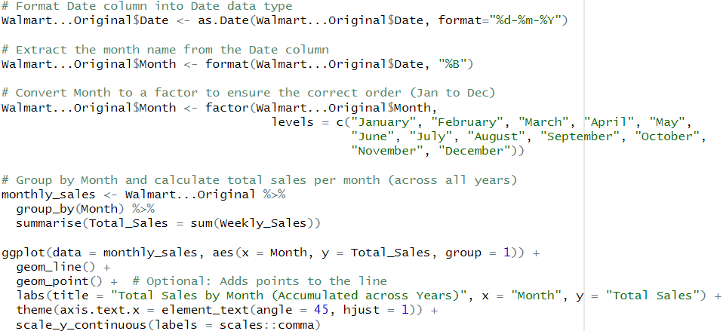
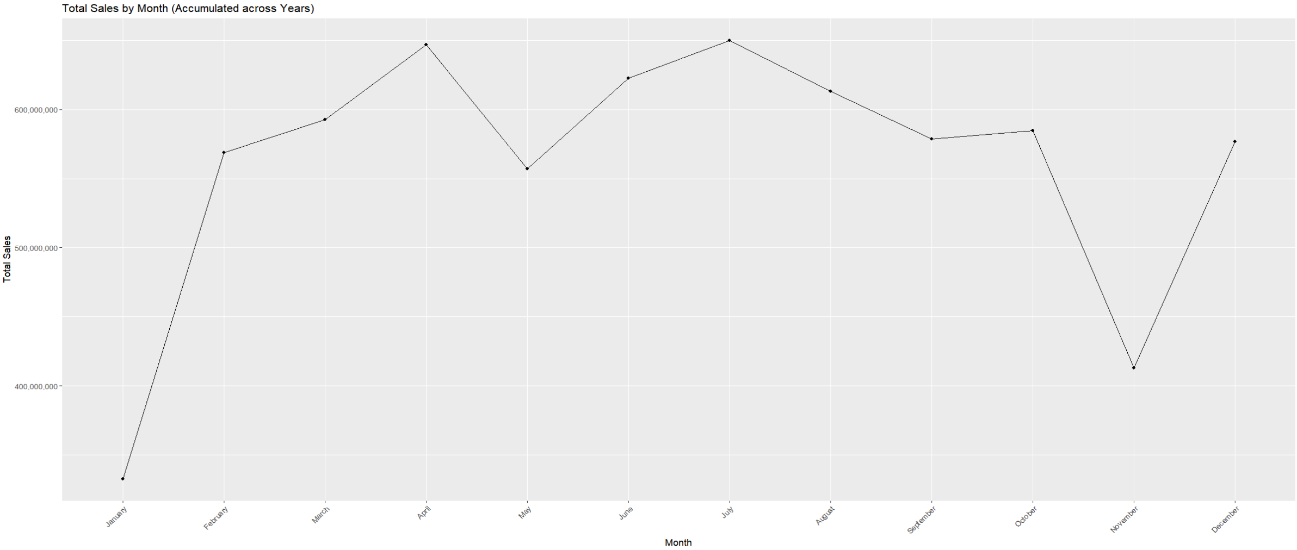
Total Sales by Month
Lowest sales: January and November (pre and post holiday period)
Highest sales: April and July (Spring and Summer breaks)
Consistently high sales between February and October

Slide 4
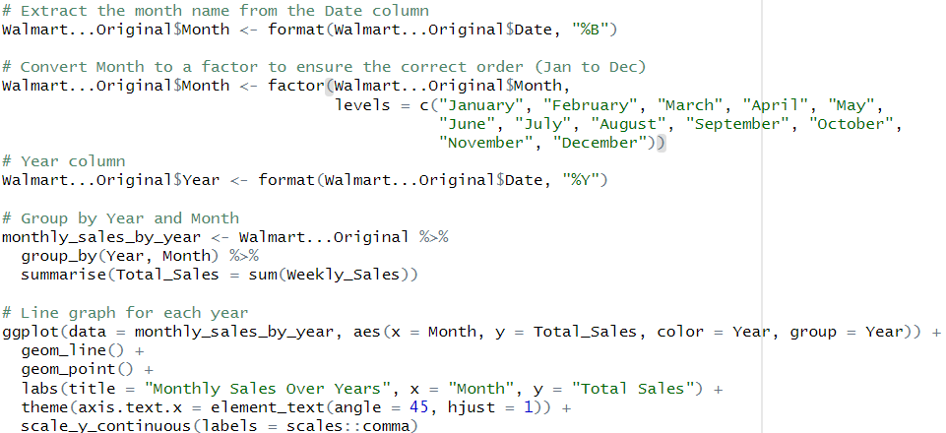
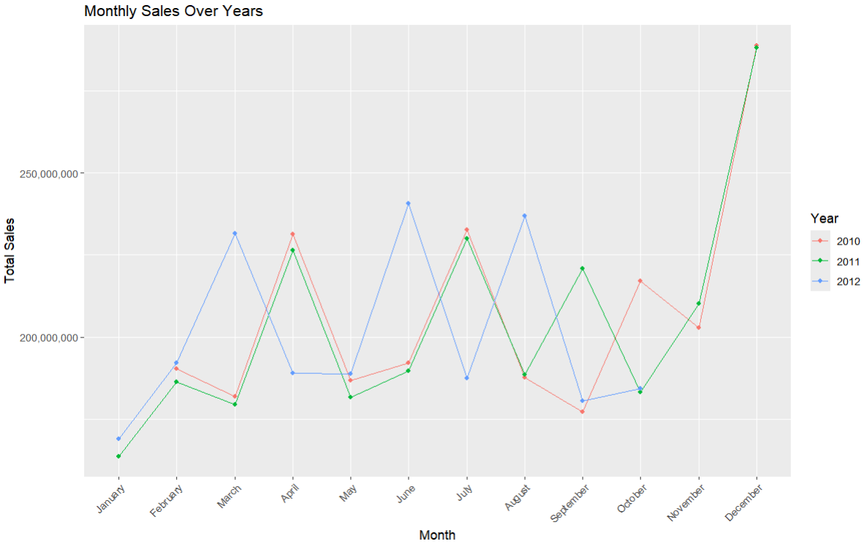
Total Sales by Month over Years
2010 and 2011 has a very similar pattern in sales over many of the months, such as February to July and in December.
2012 has a different pattern with sales high in March instead of April, and June and August instead of July.
However, every year the lowest sales is consistently January, suggesting a need for possible sales promotions and business activities to boost sales after the Christmas period.

Slide 5
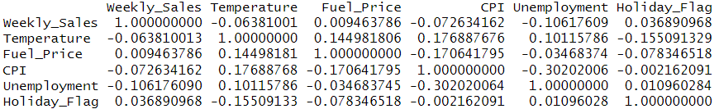
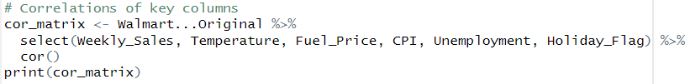
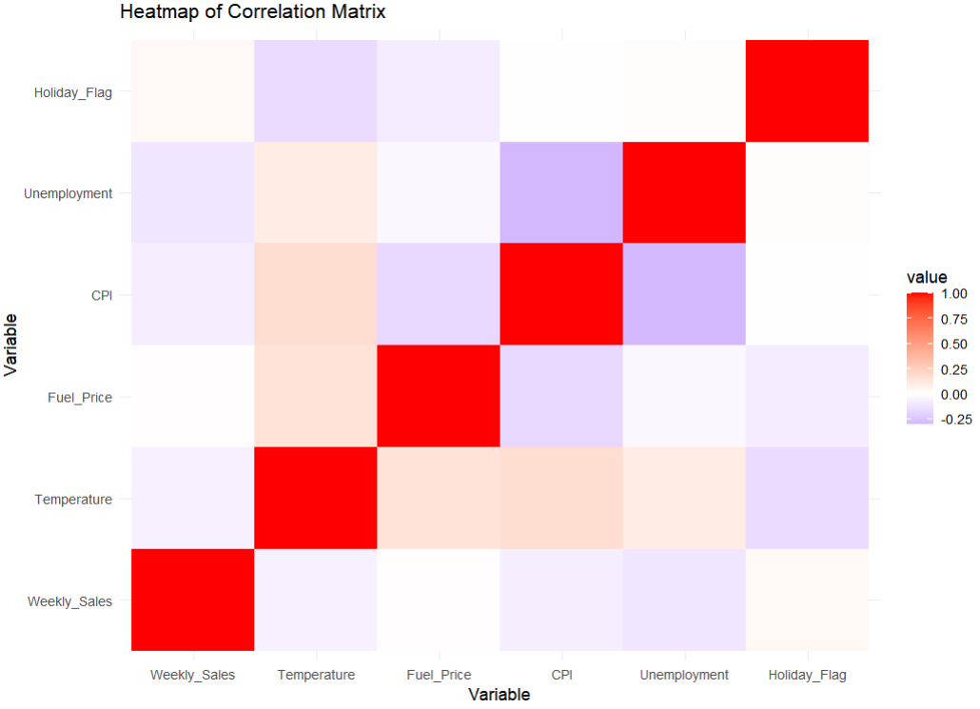
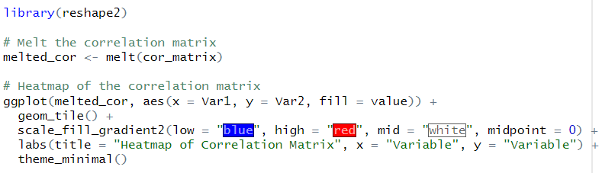
Correlations
Notable correlations:
CPI and Unemployment (-0.302): As unemployment increases, CPI tends to lightly decrease.
Possibly due to less purchases leading to lower demand and lower prices.
CPI and Temperature (0.177): Higher temperature could be associated with higher CPI.
Possibly due to seasonal demands, e.g. hot weather leading to more purchases of cold drinks.
CPI and Fuel Price (-0.171): Higher fuel prices could be associated with lower CPI.
Possibly due to less purchases on fuel leading to lower demands and CPI.
The weaker correlations suggest that weekly sales and holidays are not significantly affects by other factors, e.g. unemployment rate.

Slide 6
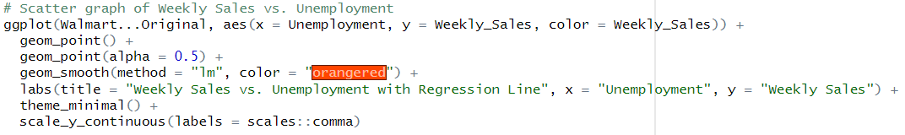
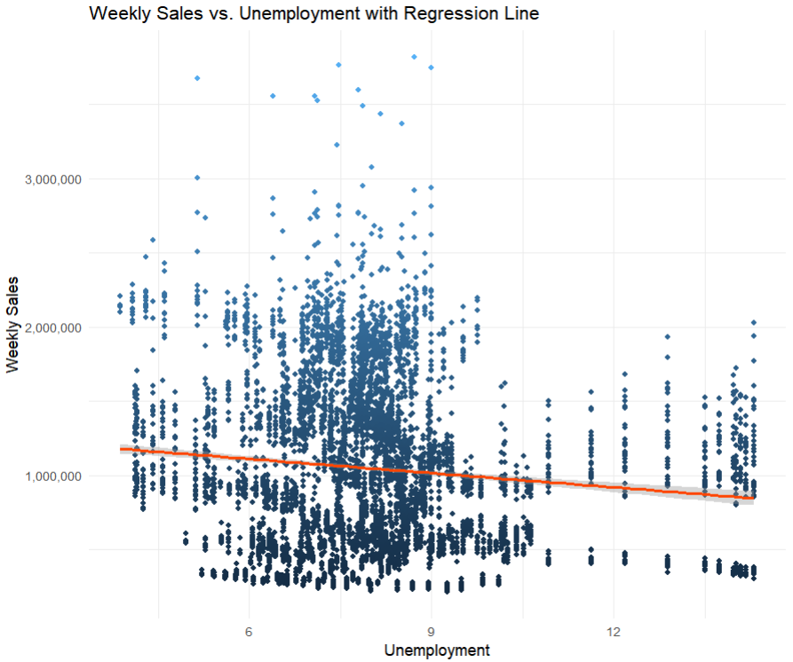
Weekly Sales by Unemployment Rate
Correlation: -0.106 (low negative correlation rate)
Weekly Sales could slightly decrease when unemployment rate increases.

Slide 7
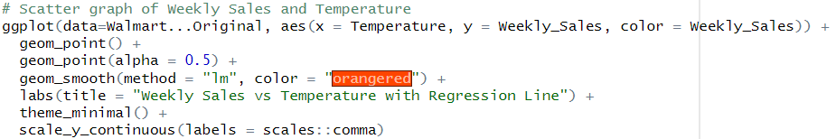
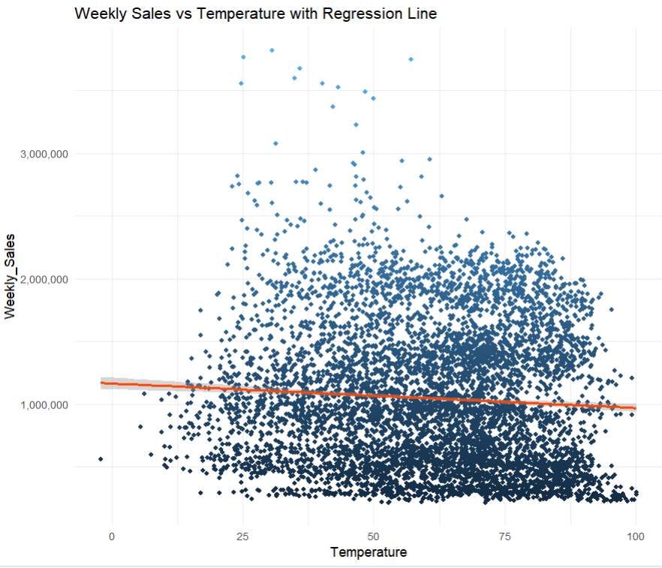
Weekly Sales by Temperature
Correlation: -0.064 (very low negative correlation rate)
Weekly Sales could slightly decrease when temperature rises.

Slide 8


Key Statistics
Weekly sales
Lowest: $209,986.2
Highest: $3,818,687
Average: $1,046,965
Weekly Unemployment Rate
Lowest: 3.9%
Highest: 14.3%
Average: 8%

Slide 9
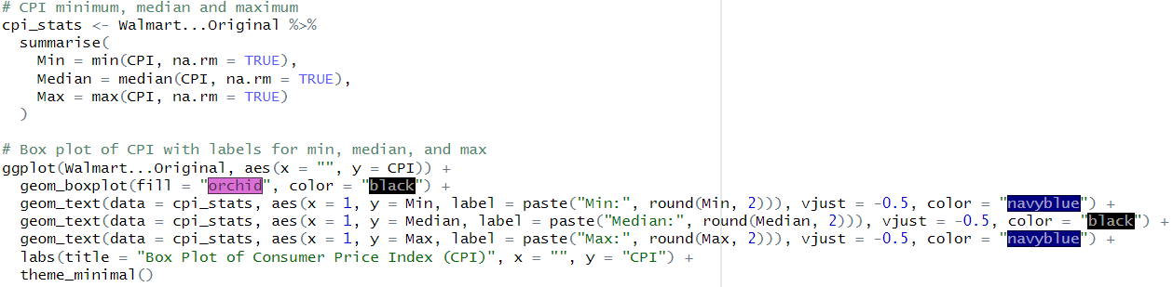
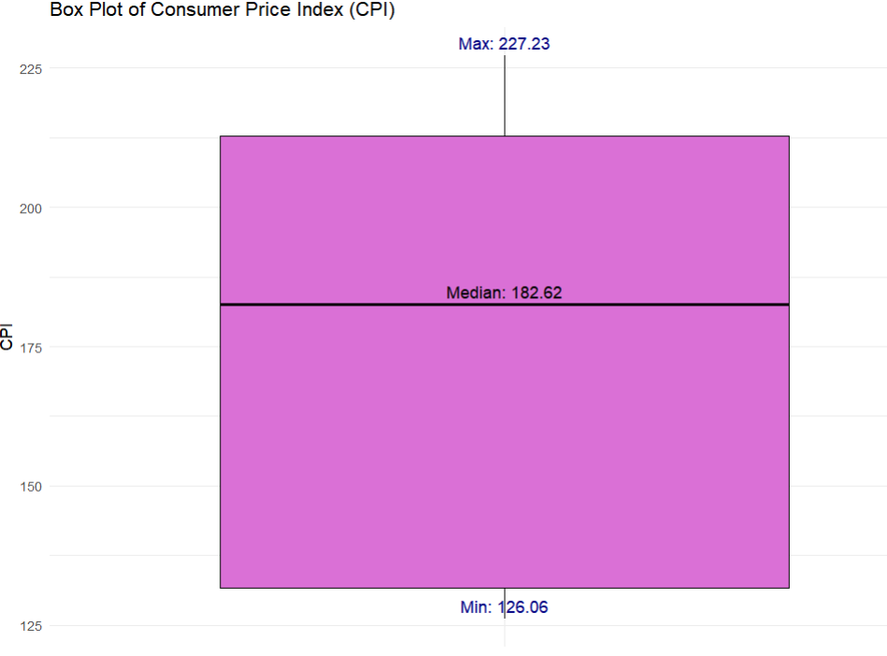
CPI Statistics
CPI
Lowest: 126.06
Highest: 227.23
Median: 182.62

Slide 10
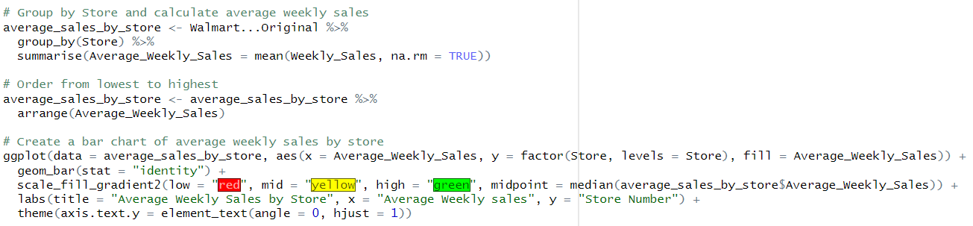
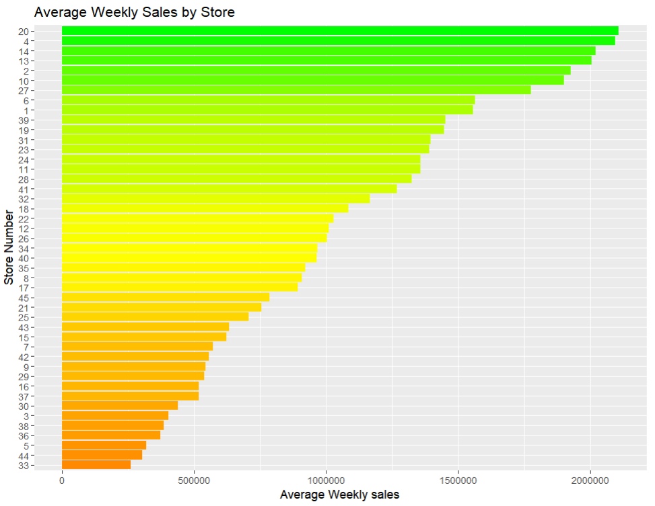
Average Weekly Sales by Store
Ranking top 5 stores in weekly sales:
20
4
14
13
2
Possible rewards for highest selling stores
Ranking bottom 5 stores in weekly sales:
33
44
5
36
38
Increase business opportunities and advertisements

